Slide 1

Experiencing M I S
Ninth Edition
Chapter Extension 1
Introduction to Microsoft Excel 2019
Copyright © 2021, 2019, 2017 Pearson Education, Inc. All Rights Reserved
Notes:
If this PowerPoint presentation contains mathematical equations, you may need to check that your computer has the following installed:
1) MathType Plugin
2) Math Player (free versions available)
3) NVDA Reader (free versions available)
This chapter extension teaches basic skills with Microsoft Excel, a product for creating and processing spreadsheets.
If you already know how to use Excel, use this chapter extension for review. Otherwise, use this chapter extension to gain essential knowledge that every businessperson needs today.

Slide 2
Study Questions
CE1-1 What is a spreadsheet?
CE1-2 How do you get started with Excel?
CE1-3 How can you enter data?
CE1-4 How can you insert and delete rows and columns and change their size?
CE1-5 How can you format data?
CE1-6 How can you create a (simple) formula?
CE1-7 How can you print results?
Notes:
This chapter extension teaches basic skills with Microsoft Excel, a product for creating and processing spreadsheets. If you already know how to use Excel, use this chapter extension for review.

Slide 3
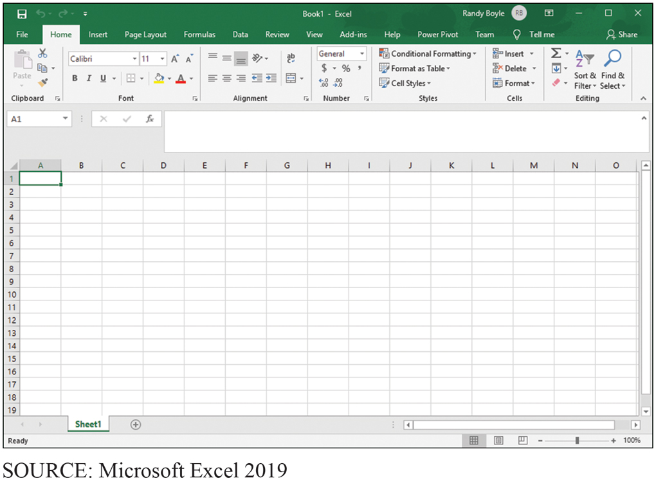
An Excel Spreadsheet
CE1-1 What is a spreadsheet?
Figure C E 1-1 Excel Spreadsheet Showing Rows and Columns
Notes:
Excel spreadsheets have rows and columns. The rows are identified by numbers, and the columns are identified by letters.

Slide 4
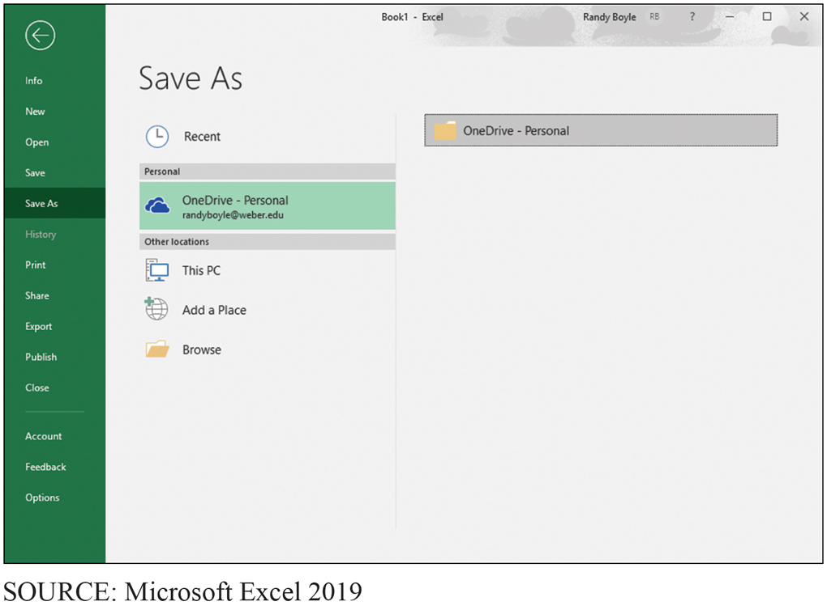
Saving Your Workbook in Excel
CE1-2 How do you get started with Excel?
Figure C E 1-2 Saving Your Workbook in Excel
Notes:
Select File, Save As, then Computer, followed by a folder.

Slide 5
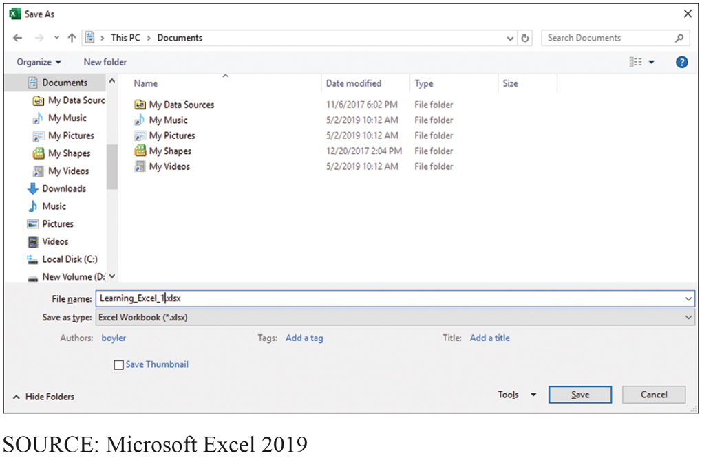
Entering a File Name in Excel
CE1-2 How do you get started with Excel?
Figure C E 1-3 Entering a File Name in Excel
Notes:
Enter file name and file type.

Slide 6
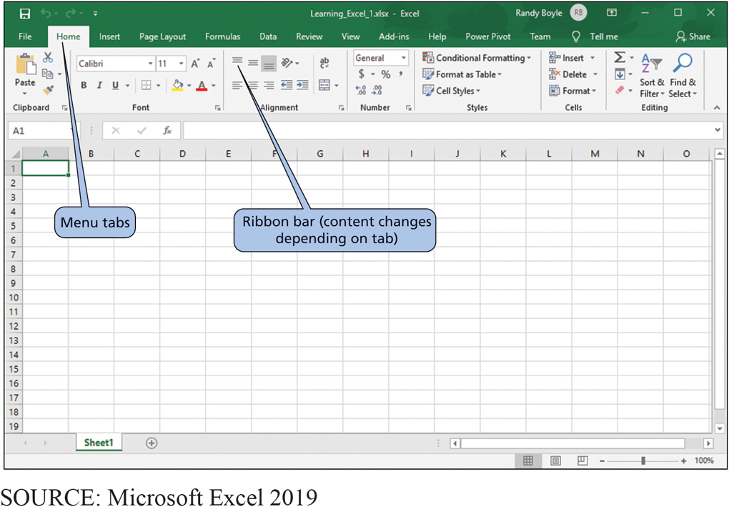
Excel Menu Tabs and Ribbon Bar
CE1-2 How do you get started with Excel?
Figure C E 1-4 Excel Menu Tabs and Ribbon Bar

Slide 7
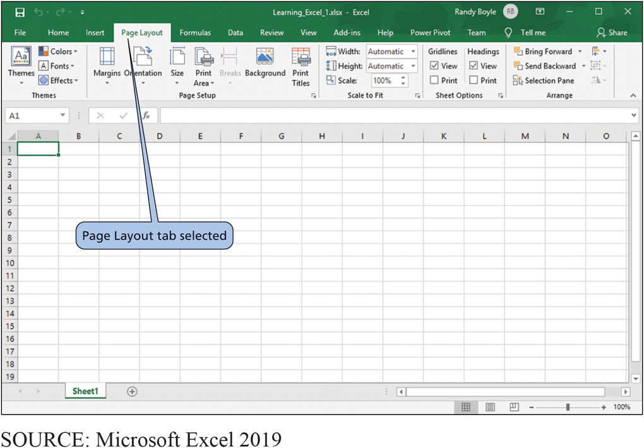
Ribbon with Page Layout Tab Selected
CE1-2 How do you get started with Excel?
Figure C E 1-5 Ribbon with Page Layout Tab Selected
Notes:
Home tab for general work, the tools and selection are the most useful
Insert tab for pictures, graphs, hyperlinks, or other items into your spreadsheet
Page Layout tab to format your page, often for printing
Formulas tab to create more complex formulas
Data tab for filtering and sorting data in your spreadsheet
Review tab for tracking changes and making comments
View tab for configuring the appearance of Excel
Add-Ins tab for using nonstandard features that have been added to Excel, such as PowerPivot and Team shown

Slide 8
Entering Data in Excel
CE1-3 How can you enter data?
Three general methods
Key in the data
Let Excel add data based on a pattern
Import from another file or program

Slide 9
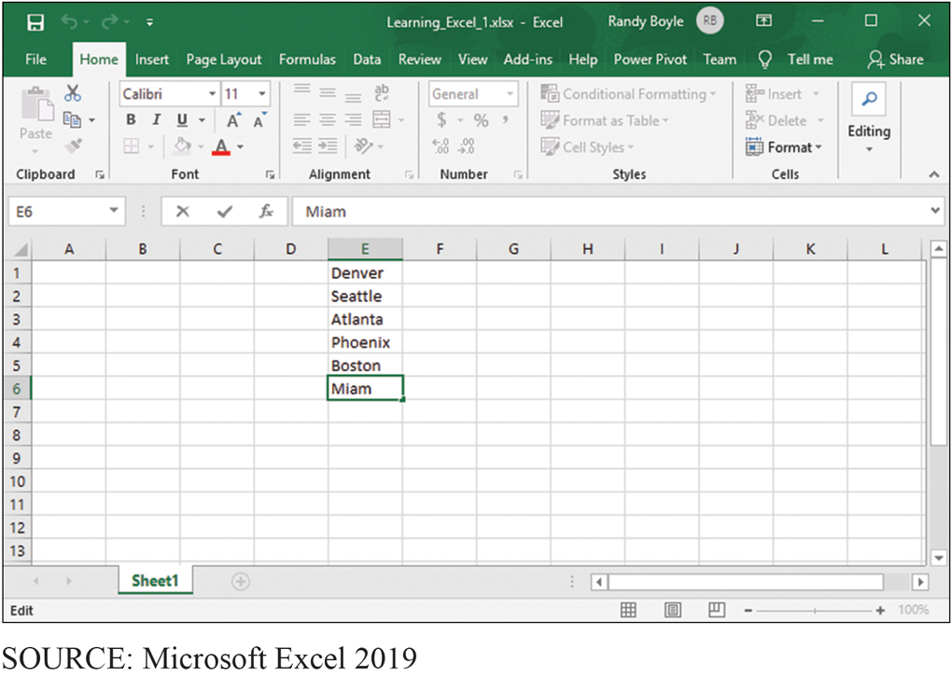
Entering City Names in Column E
CE1-3 How can you enter data?
Figure C E 1-6 Entering City Names in Column E
Notes:
The user has keyed names of cities into column E and is in the process of adding Miami.

Slide 10
Let Excel Add Data Using a Pattern
CE1-3 How can you enter data?
Automatically repeat items already entered
Use fill handle to fill data
Fill data into adjacent cells
Fill formulas into adjacent cells
Fill a series of numbers, dates, or other built-in series items
Fill data using a custom fill series

Slide 11
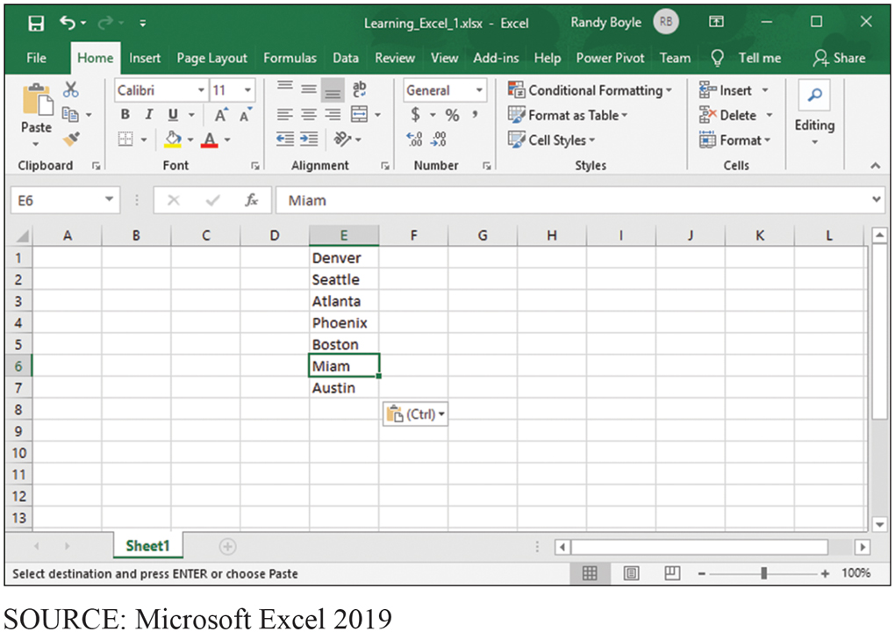
Using a Function Key to Make Entry Corrections
CE1-3 How can you enter data?
Figure C E 1-7 Using a Function Key to Make Entry Corrections
Notes:
Use the F2 key to make corrections without retyping the whole entry.

Slide 12
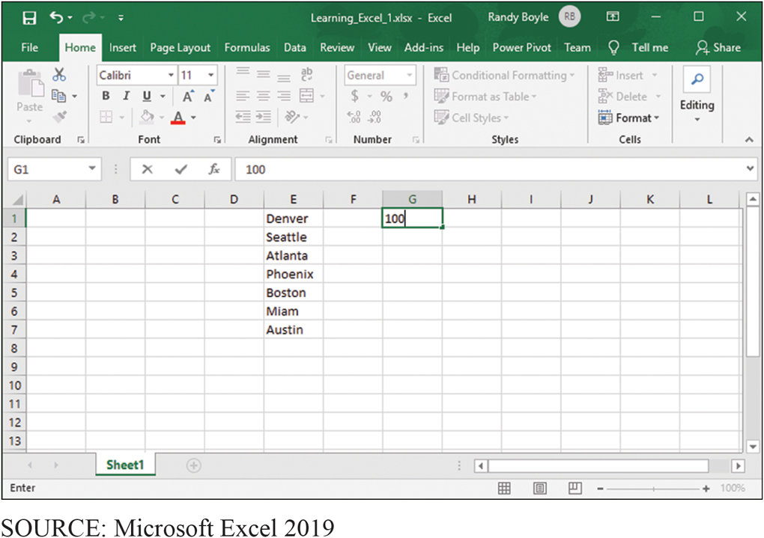
Entering Identical Data in Multiple Cells: Step 1
CE1-3 How can you enter data?
Figure C E 1-8 Entering Identical Data in Multiple Cells, Step 1
Notes:
Click and drag the little black box in the lower right-hand corner.

Slide 13
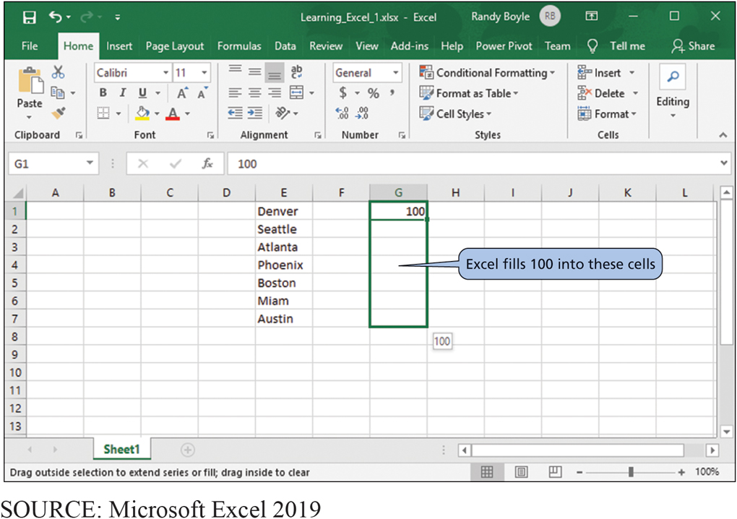
Entering Identical Data in Multiple Cells: Step 2
CE1-3 How can you enter data?
Figure C E 1-9 Entering Identical Data in Multiple Cells, Step 2
Notes:
Drag—left-click and hold the mouse button down as you move the mouse.

Slide 14
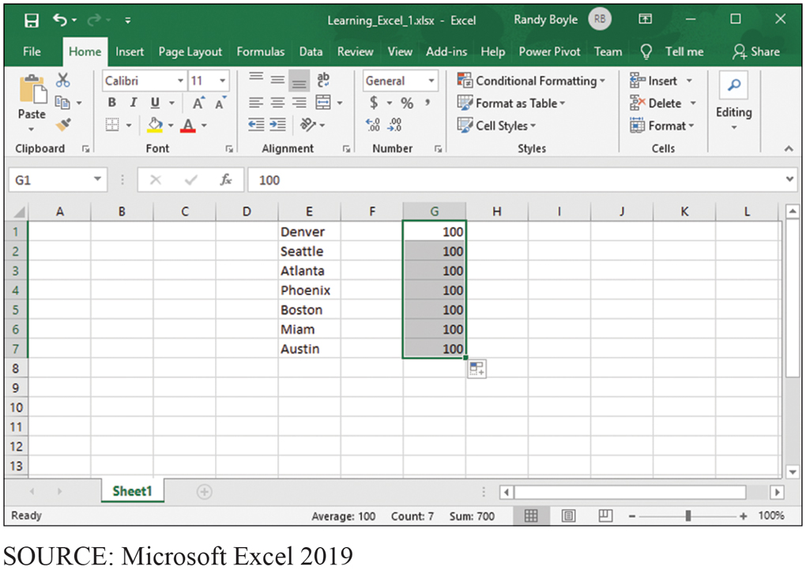
Identical Data Entered in Multiple Cells
CE1-3 How can you enter data?
Figure C E 1-10 Identical Data Entered in Multiple Cells

Slide 15
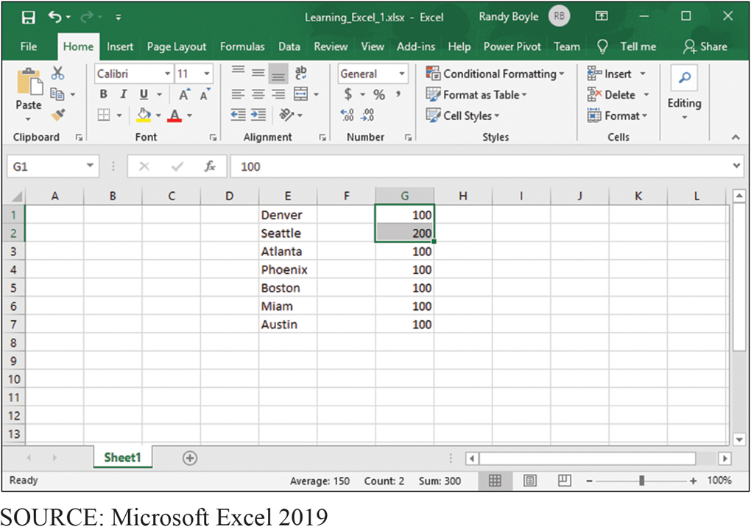
Entering Patterned Data in Multiple Cells
CE1-3 How can you enter data?
Figure C E 1-11 Entering Patterned Data into Multiple Cells

Slide 16
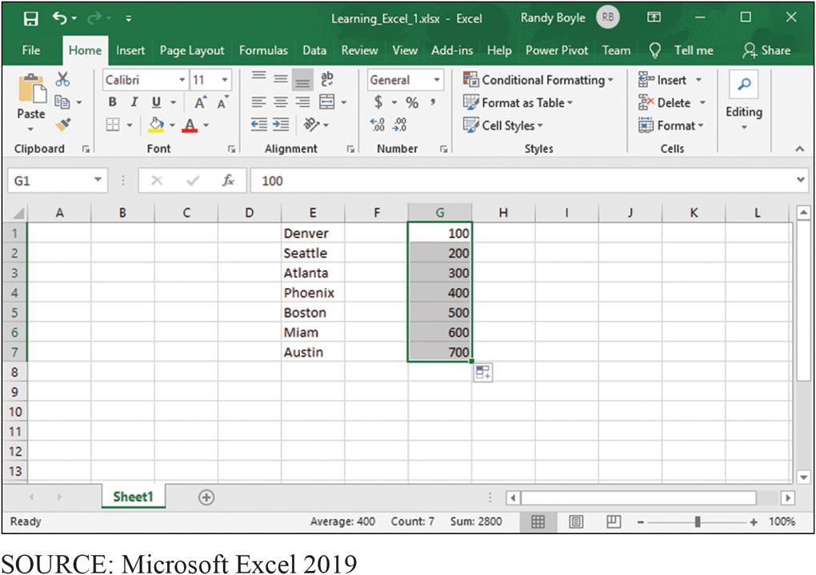
Patterned Data Entered in Multiple Cells
CE1-3 How can you enter data?
Figure C E 1-12 Patterned Data Entered in Multiple Cells

Slide 17
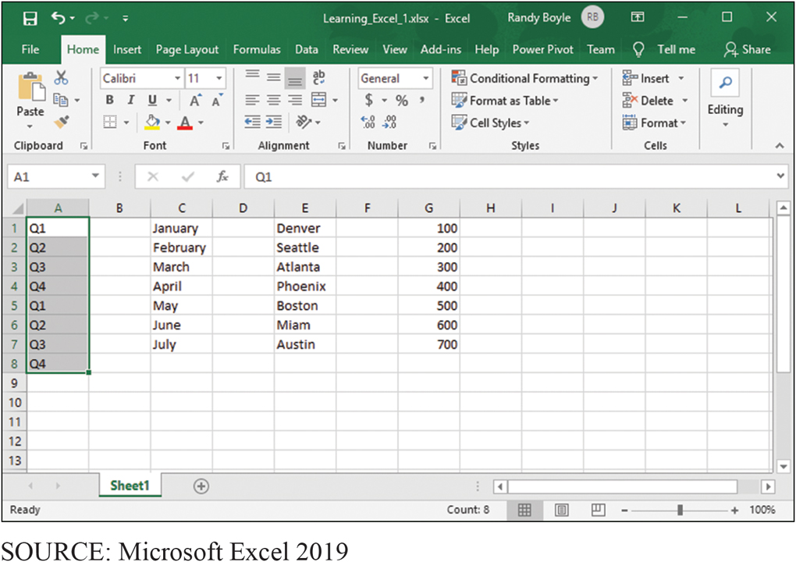
Sophisticated Entry of Patterned Data in Multiple Cells
CE1-3 How can you enter data?
Figure C E 1-13 Sophisticated Entry of Patterned Data in Multiple Cells
Notes:
If you key January and February into cells C1 and C2 and then select both cells and drag down, Excel will fill in with March, April, May, and so on. Or, if in column A you key in the sequence Q1, Q2, Q3, and Q4, Excel will repeat pattern.

Slide 18
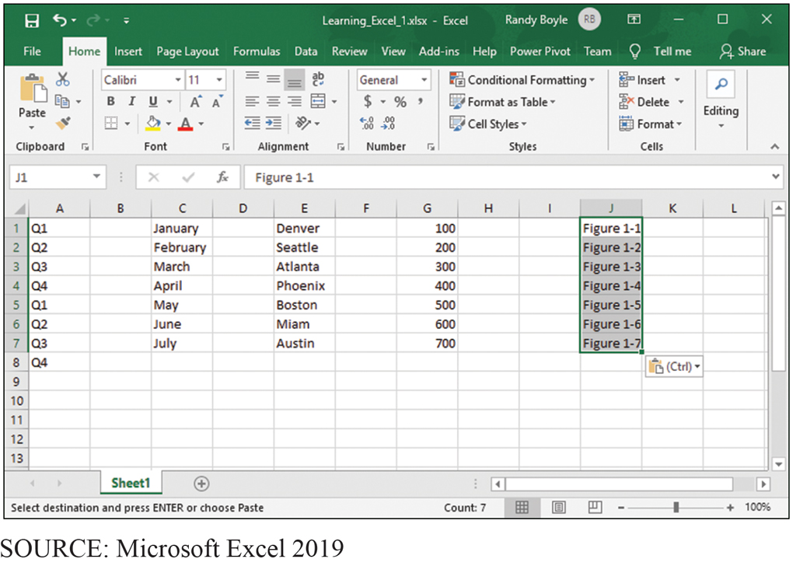
Patterned Data Within Text Values
CE1-4 How can you insert and delete rows and columns and change their size?
Figure C E 1-14 Patterned Data Within Text Values
Notes:
Select and drag.

Slide 19
Inserting and Deleting Rows and Columns and Changing Their Size
CE1-4 How can you insert and delete rows and columns and change their size?
Insert rows
Left-click in row number above where new row(s) to be inserted.
Click right mouse button, select Insert from menu.
Delete rows—Click right mouse button, select Insert from menu.
Change row size
Click and hold on bottom of row number (cursor changes to vertical bar).
Drag mouse to desired row height.

Slide 20
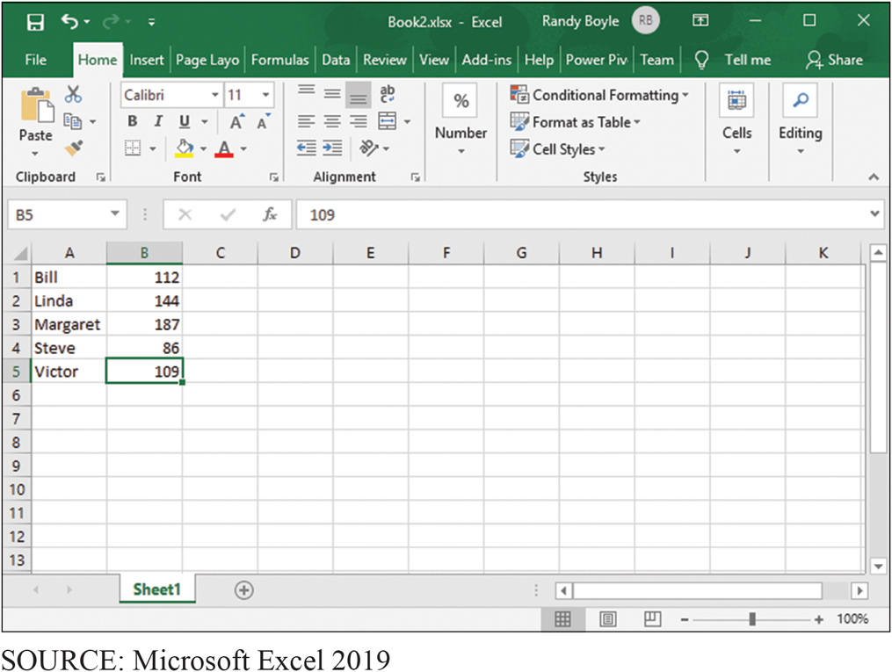
Spreadsheet to Which User Wants to Add New Rows for Column Headings
CE1-4 How can you insert and delete rows and columns and change their size?
Figure C E 1-15 Spreadsheet to Which User Wants to Add New Rows for Column Headings

Slide 21
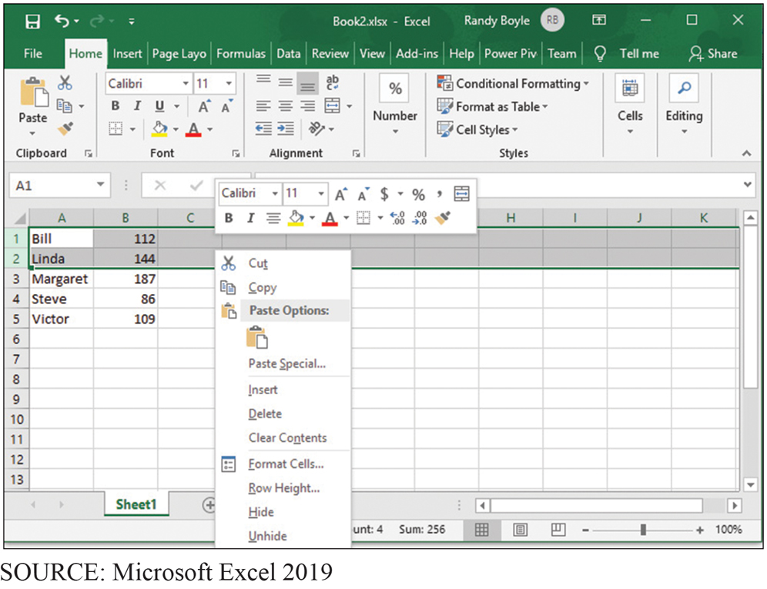
Menu for Adding Inserts Such as New Rows
CE1-4 How can you insert and delete rows and columns and change their size?
Figure C E 1-16 Menu for Adding Inserts Such as New Rows
Notes:
Alternative method using the right-click menu list.

Slide 22
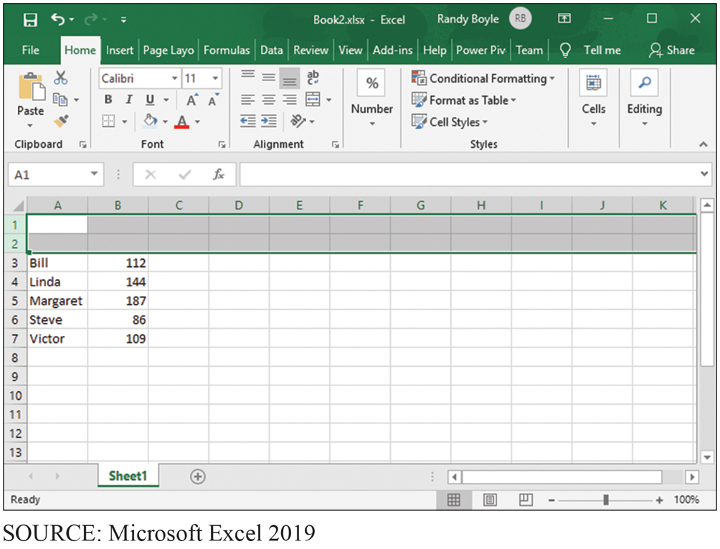
Spreadsheet to Which User Has Added New Rows for Column Headings
CE1-4 How can you insert and delete rows and columns and change their size?
Figure C E 1-17 Spreadsheet to Which User Has Added New Rows for Column Headings

Slide 23
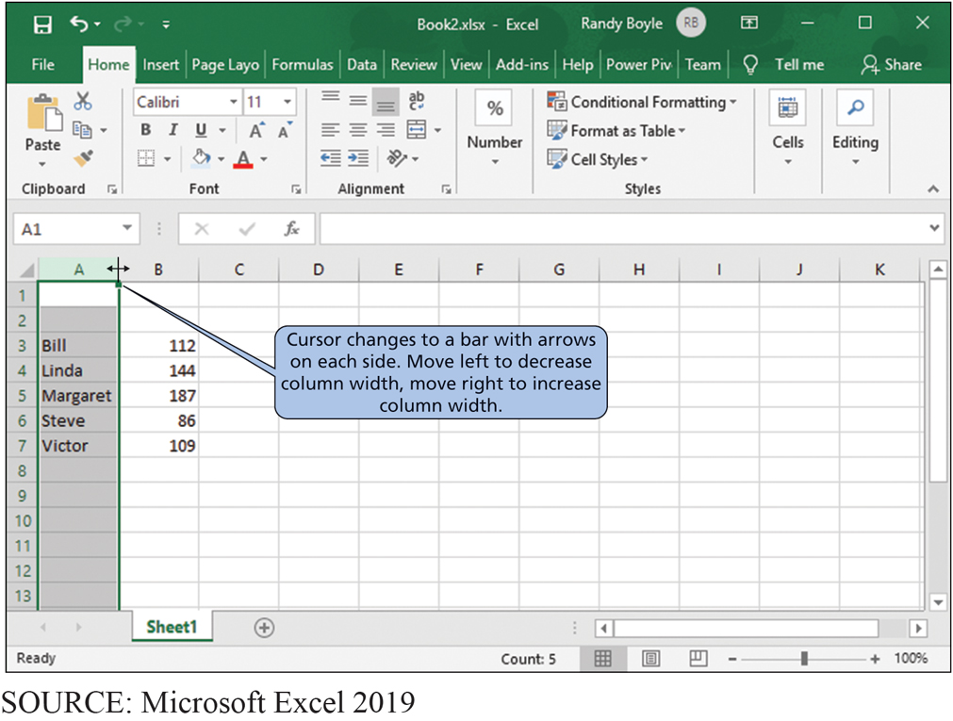
Changing Cursor to a Vertical Bar to Change Column Widths
CE1-4 How can you insert and delete rows and columns and change their size?
Figure C E 1-18 Changing Cursor to a Vertical Bar to Change Column Widths

Slide 24
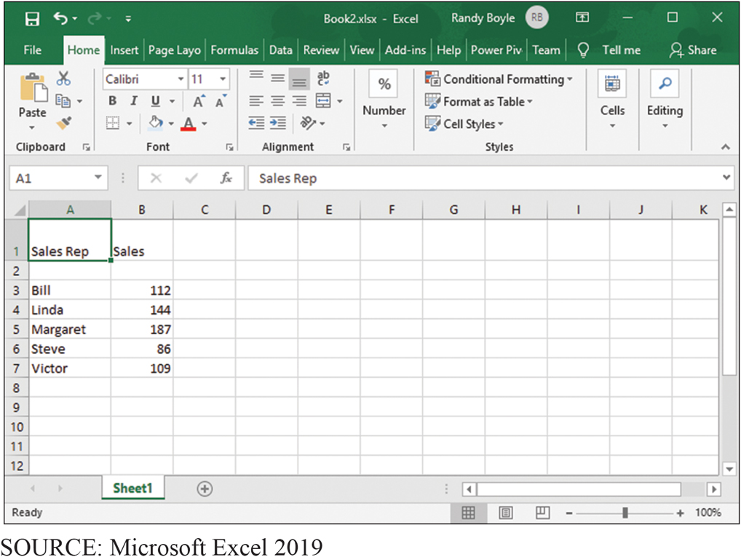
Spreadsheet with Rows Added and Sizes of Columns Changed
CE1-4 How can you insert and delete rows and columns and change their size?
Figure C E 1-19 Spreadsheet with Rows Added and Sizes of Columns Changed

Slide 25
Formatting Data
CE1-5 How can you format data?
Ribbon options
Alignment (left, center, right) within cell
Font size, style, color
Number style—currency, comma, percentage, number of decimal places
Cell lines and borders

Slide 26
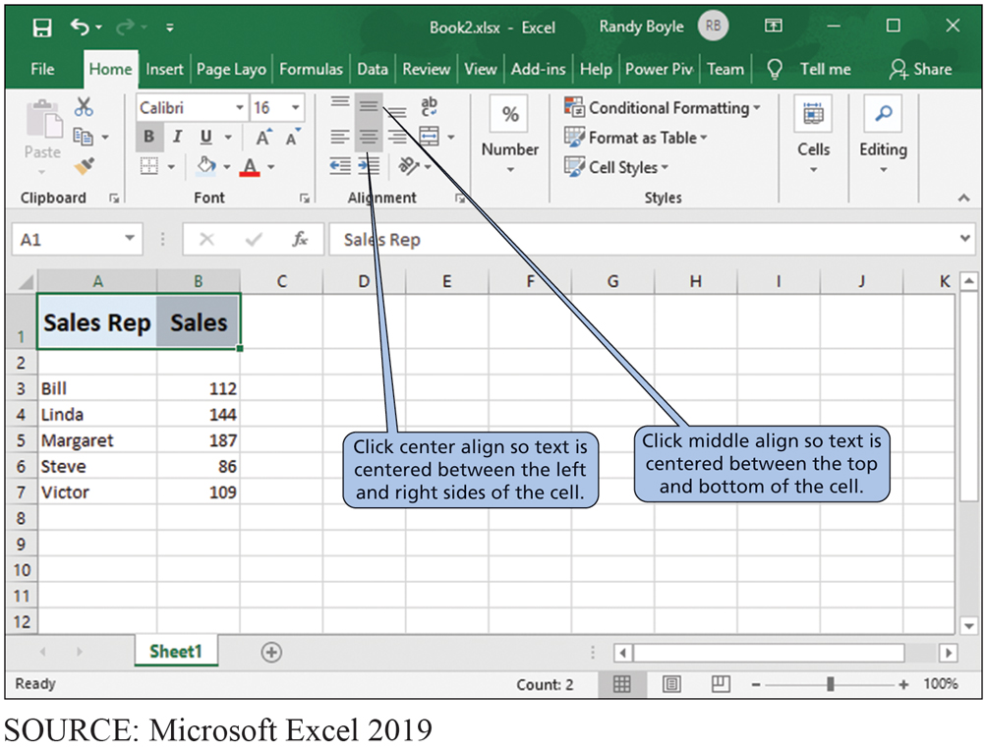
Centering Labels in Cells
CE1-5 How can you format data?
Figure C E 1-20 Centering Labels in Cells

Slide 27
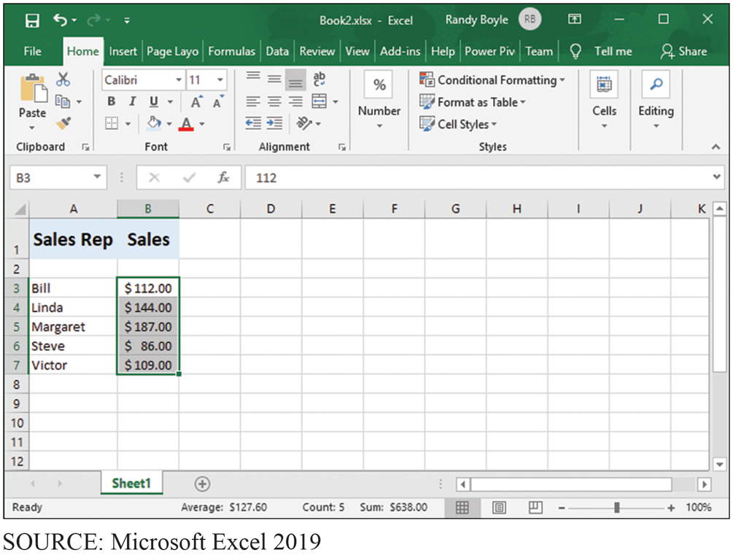
Adding Dollar Signs in Cells
CE1-5 How can you format data?
Figure C E 1-21 Adding Dollar Signs in Cells

Slide 28
Creating a (Simple) Formula
CE1-6 How can you create a (simple) formula?
Formula
Key in:
Copy and paste formula to other cells.
Use built-in function such as SUM.

Slide 29
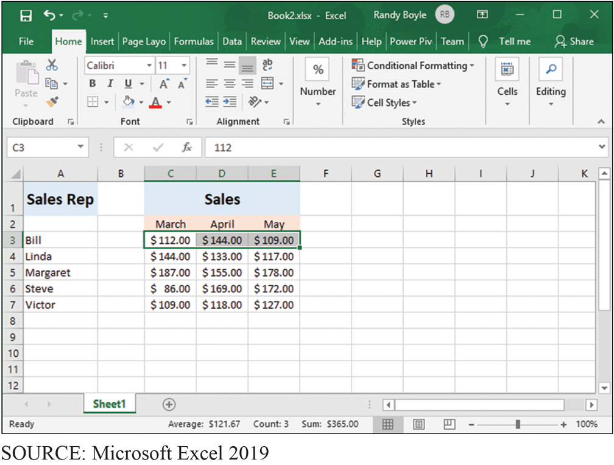
Selecting Cells to Be Summed
CE1-6 How can you create a (simple) formula?
Figure C E 1-22 Selecting Cells to Be Summed
Notes:
Select the range of cells to sum.

Slide 30
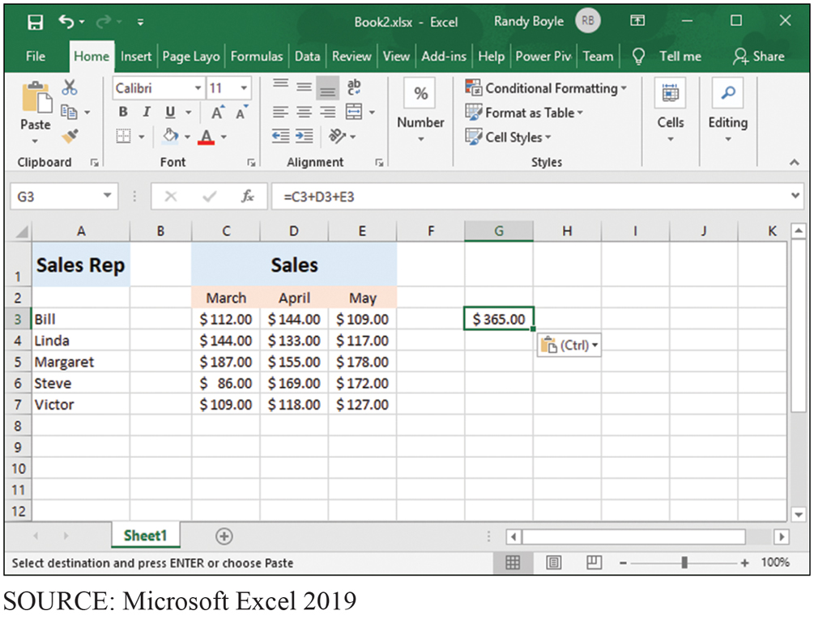
The Result of Applying a Formula That Summed Cells C3, D3, and E3
CE1-6 How can you create a (simple) formula?
Figure C E 1-23 The Result of Applying a Formula That Summed Cells C3, D3, and E3

Slide 31
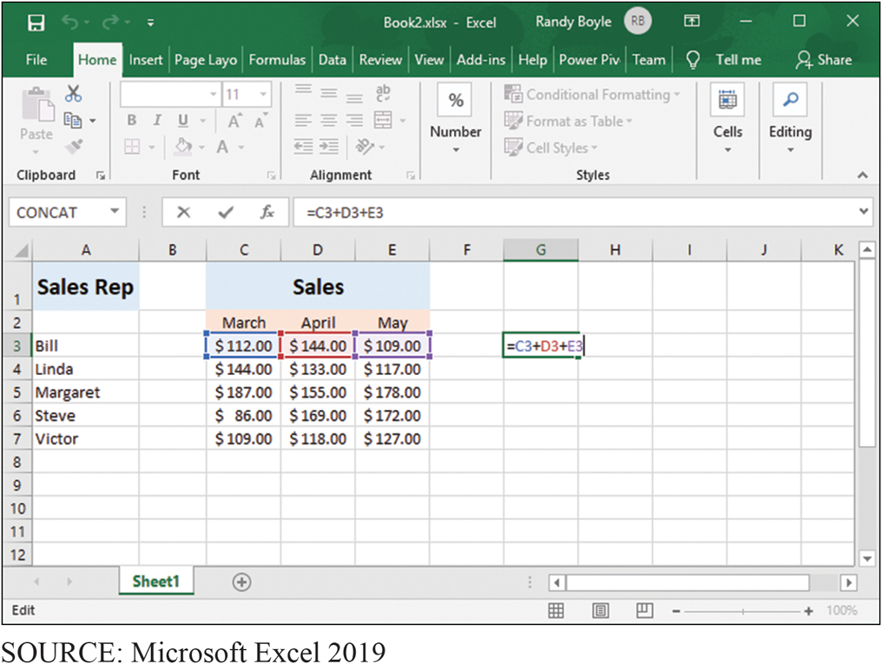
Using the F2 Function Key to Show Color Coding of Cells Involved in a Calculation
CE1-6 How can you create a (simple) formula?
Figure C E 1-24 Using the F2 Function Key to Show Color Coding of Cells Involved in a Calculation
Notes:
Shift+F2 adds or edits a cell comment.
Ctrl+F2 displays the print preview area on the Print tab in the Backstage view.

Slide 32
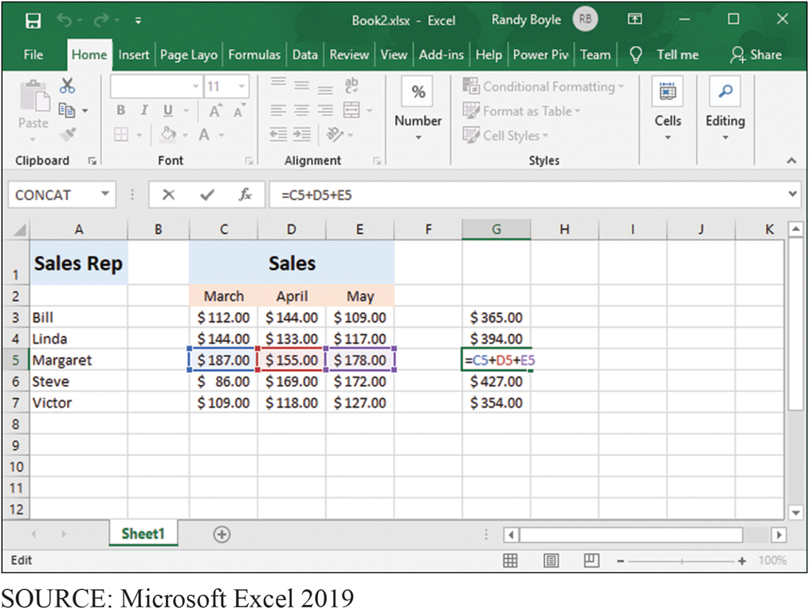
Using the F2 Function Key to Confirm That a Formula Was Correctly Copied
CE1-6 How can you create a (simple) formula?
Figure C E 1-25 Using the F2 Function Key to Confirm That a Formula Was Correctly Copied into Multiple Cells
Notes:
Use Excel Help and search for “keyboard shortcuts”.

Slide 33
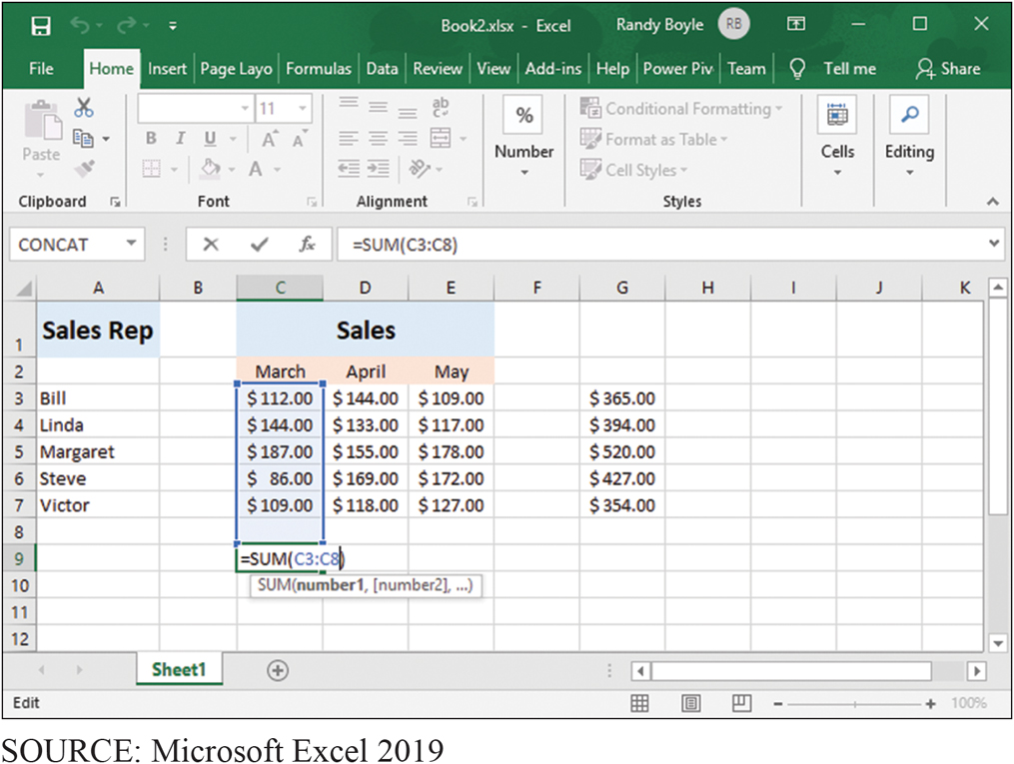
Auto Sum Function
CE1-7 How can you print results?
Figure C E 1-26 Auto Sum Function
Notes:
=SUM(C3:C8)

Slide 34
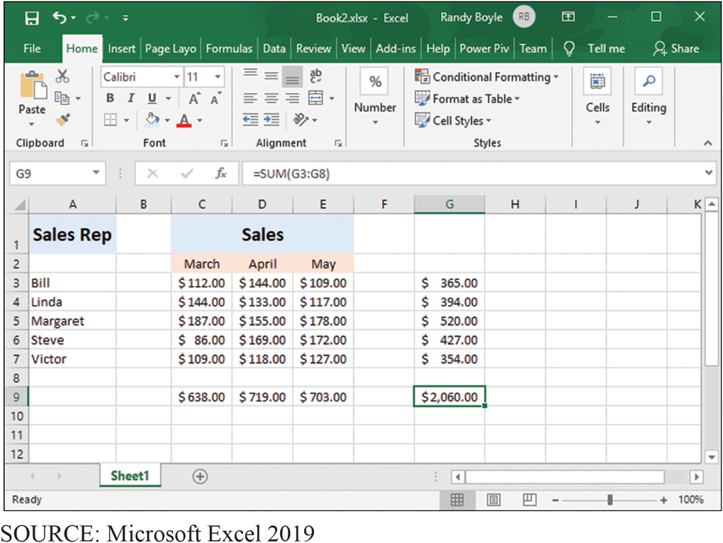
Summing Sales by Month
CE1-7 How can you print results?
Figure C E 1-27 Summing Sales by Month

Slide 35
Printing Your Results
CE1-7 How can you print results?
Print Preview, Page Layout, and Specifying a Print Area.
Print Preview
To save paper and ink
Page Layout tab
Sheet Options
View and print with gridlines
Headings
Orientation: Landscape or Portrait
Print area
Specify a portion of worksheet to print

Slide 36
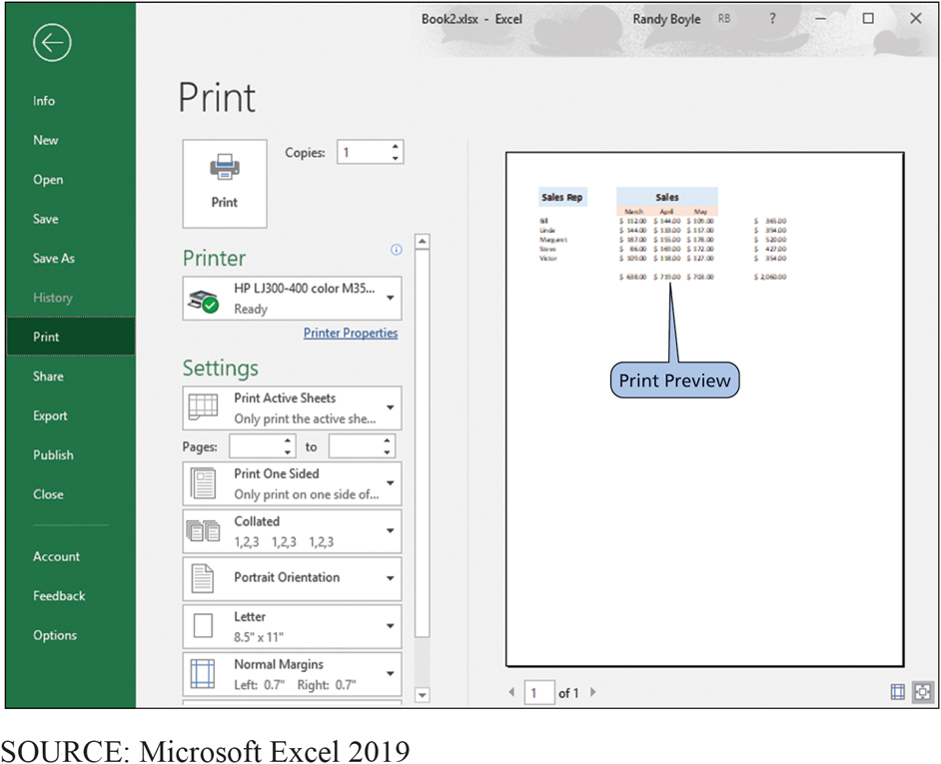
The Print Preview Screen in Excel
CE1-7 How can you print results?
Figure C E 1-28 The Print Preview Screen in Excel

Slide 37
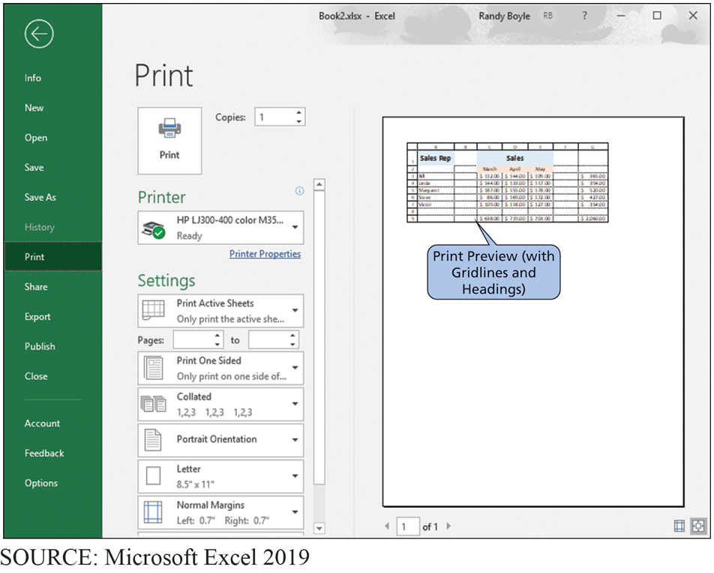
Using Print Preview to View the Spreadsheet with Gridlines and Headings
CE1-7 How can you print results?
Figure C E 1-29 Using Print Preview to View the Spreadsheet with Gridlines and Headings

Slide 38
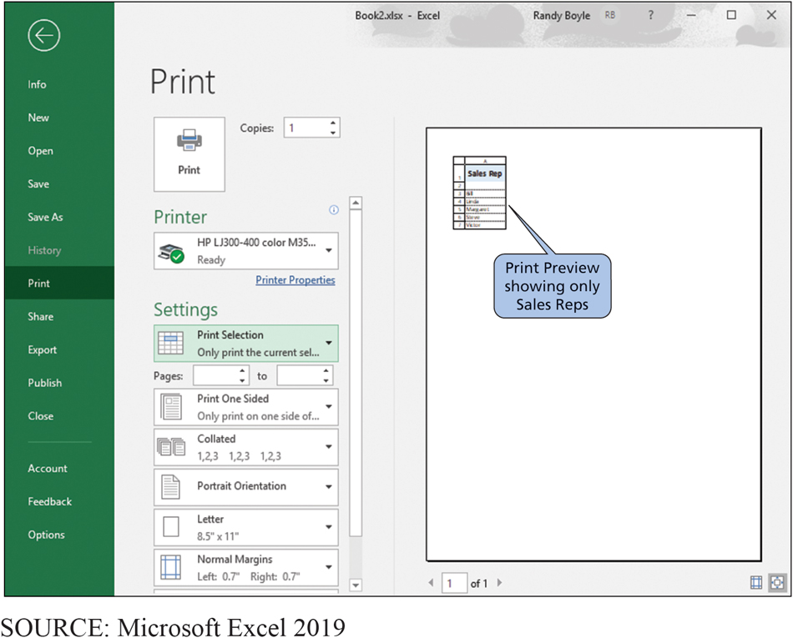
Using Print Preview to Select Only a Portion of the Spreadsheet
CE1-7 How can you print results?
Figure C E 1-30 Using Print Preview to Select Only a Portion of the Spreadsheet

Slide 39
Active Review
CE1-1 What is a spreadsheet?
CE1-2 How do you get started with Excel?
CE1-3 How can you enter data?
CE1-4 How can you insert and delete rows and columns and change their size?
CE1-5 How can you format data?
CE1-6 How can you create a (simple) formula?
CE1-7 How can you print results?

Slide 40

Copyright

